Slide 1
Manufacturing SOPs
Increasing Effectiveness, Decreasing Risks
June 2022
Notes:
*Explosion*

Slide 2
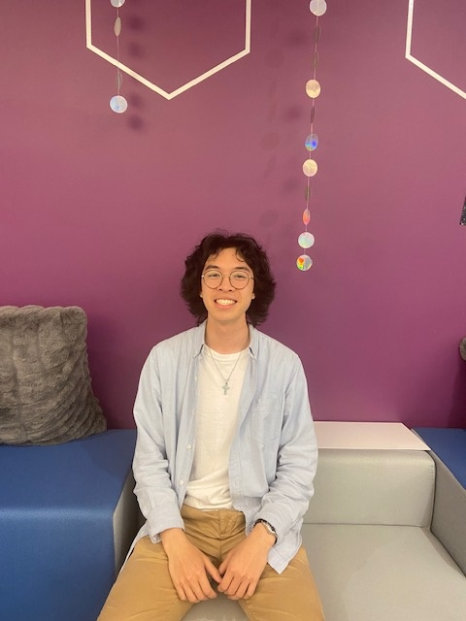
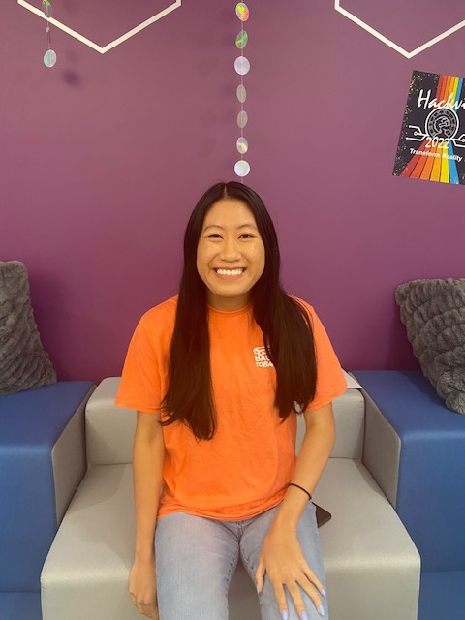

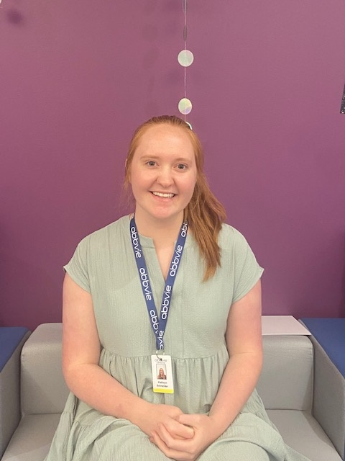

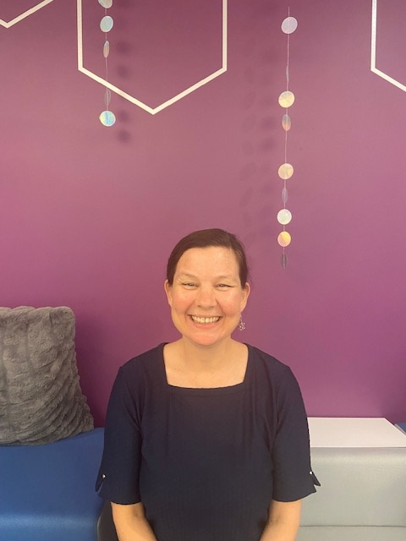
Meet Team AbbVie
Lance Wong
Full Stack Intern
Rose Huynh
Onboarding Specialist
Asvin Ragunathan
RAIDERS-Dev
Katie Schneider
MRT Team
Michael Lee
PhD Mentee
Mentor
Shannon McCumber
HackVie | Manufacturing SOPs | 2022

Slide 3
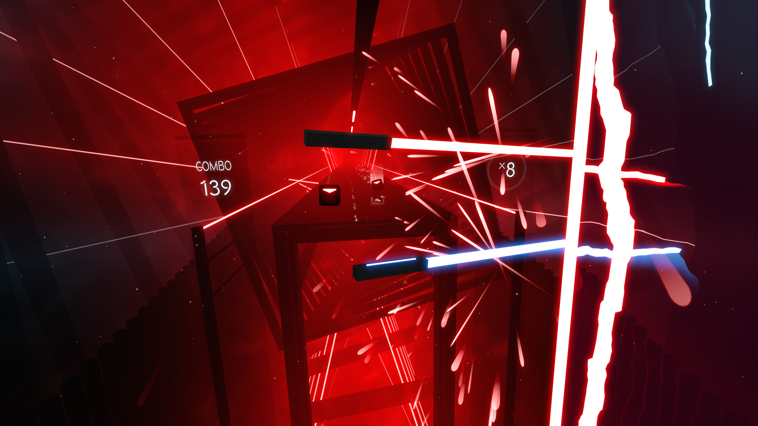
Could training be fun?
Notes:
Who here enjoys
Who here has played beat saber? Is that fun
What if reading your SOPs was as fun as playing beat saber
Source:https://uploadvr.com/download-install-new-custom-songs-beat-saber/

Slide 4
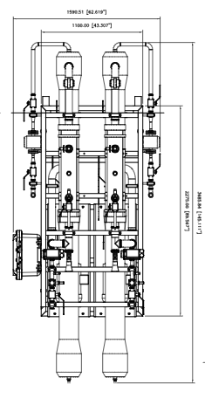

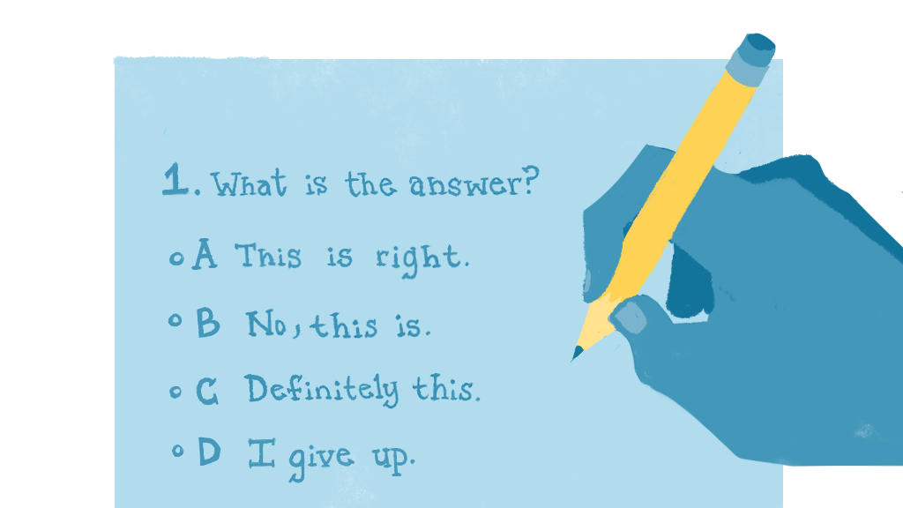
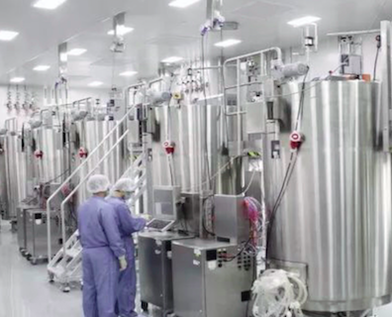
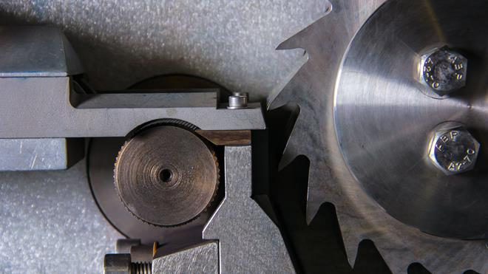
Problem: Ineffective and inadequate trainings
Difficult trainings
Defective products
Ineffective comprehension checks
Machinery damage
Workplace accidents
HackVie | Manufacturing SOPs | 2022
Notes:
The lengthy and meticulous written procedure for the operation( of the tubular UltraFilter 214 m2) of instruments and hazardous chemicals might led to numerous workplace incidents and possible defective products. New hires shift through hours of mandatory and compliance training. However, they may not be able to retain and sustain the relevance of the extensive SOPS and JTSM manuals to familiarize themselves with their positions' highly specified basic skills.*
Describe how training in general is inadequate as it is now (people skip right through it)
extreme example: lack of adequate training causing injury in the lab)
We need to address this, but how?

Slide 5
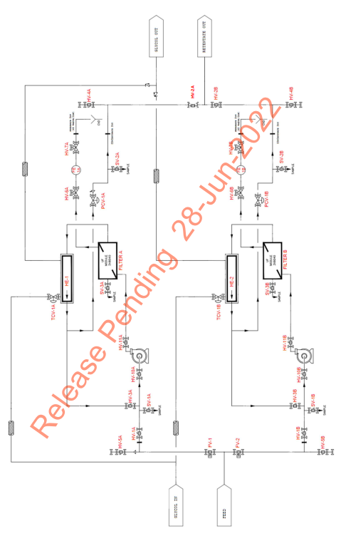
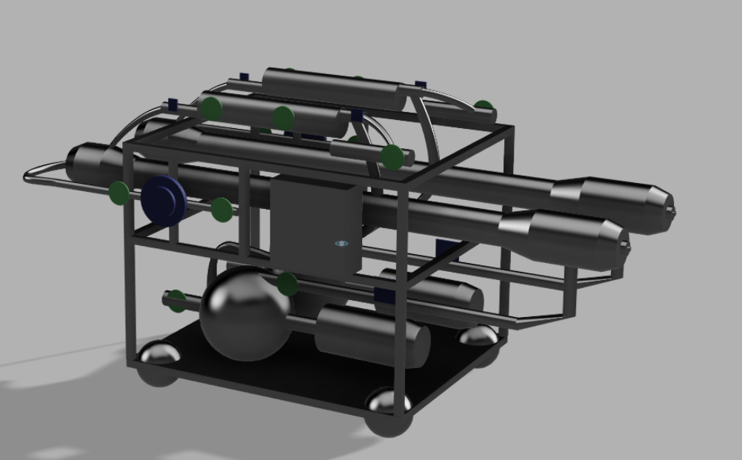
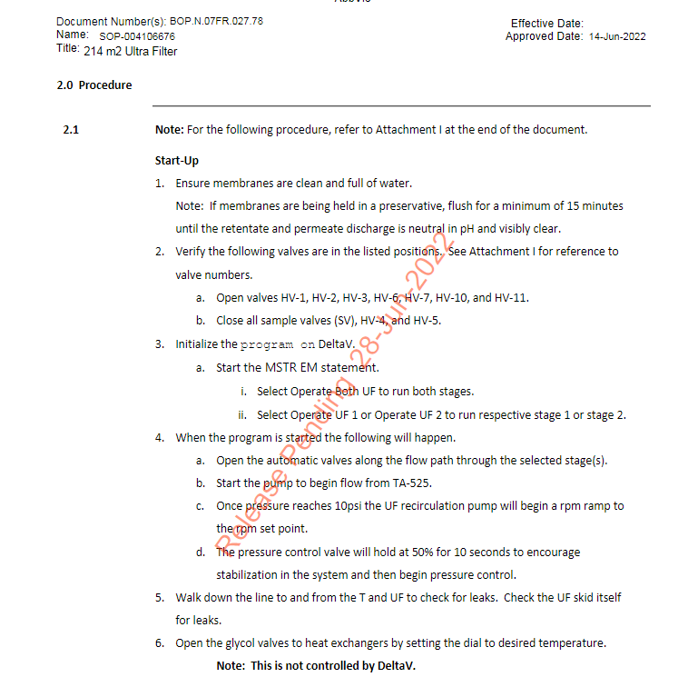
Current Training vs VR Training
Current Training Materials
TrainVR
HackVie | Manufacturing SOPs | 2022

Slide 6


VR Training Solution
HackVie | Manufacturing SOPs | 2022
Notes:
Our VR training solution is
This is a virtual simulztion in which
In our virtual simulation, trainees are taken through each step in the SOP manual
But instead of reading about the steps
They are able to complete them on the recreated equipment

Slide 7
TrainVR Specific Benefits
Simulates the equipment the trainee will be working with
HackVie | Manufacturing SOPs | 2022
Notes:
VR!
Specifically, VR that simulates the work environment and the equipment the trainee will be working with

Slide 8
TrainVR Specific Benefits
Simulates the equipment the trainee will be working with
Delivers real-time feedback
HackVie | Manufacturing SOPs | 2022
Notes:
VR!
Specifically, VR that simulates the work environment and the equipment the trainee will be working with

Slide 9
TrainVR Specific Benefits
Simulates the equipment the trainee will be working with
Delivers real-time feedback
Provides hands on experience without safety risks
HackVie | Manufacturing SOPs | 2022
Notes:
VR!
Specifically, VR that simulates the work environment and the equipment the trainee will be working with

Slide 10
General Benefits of VR Training
Simulates the equipment the trainee will be working with
Reduces onboarding time
Delivers real-time feedback
Provides hands on experience without safety risks
HackVie | Manufacturing SOPs | 2022
Notes:
VR!
Specifically, VR that simulates the work environment and the equipment the trainee will be working with

Slide 11
General Benefits of VR Training
Simulates the equipment the trainee will be working with
Reduces onboarding time
Delivers real-time feedback
Decreases incident costs
Provides hands on experience without safety risks
HackVie | Manufacturing SOPs | 2022
Notes:
VR!
Specifically, VR that simulates the work environment and the equipment the trainee will be working with

Slide 12
General Benefits of VR Training
Simulates the equipment the trainee will be working with
Reduces onboarding time
Delivers real-time feedback
Decreases incident costs
Provides hands on experience without safety risks
Accelerates speed to proficiency
HackVie | Manufacturing SOPs | 2022
Notes:
VR!
Specifically, VR that simulates the work environment and the equipment the trainee will be working with

Slide 13
Proposed Solution
Simulates the equipment the trainee will be working with
Reduces onboarding time
Delivers real-time feedback
Decreases incident costs
Provides hands on experience without safety risks
Accelerates speed to proficiency
HackVie | Manufacturing SOPs | 2022
Notes:
VR!
Specifically, VR that simulates the work environment and the equipment the trainee will be working with

Slide 14
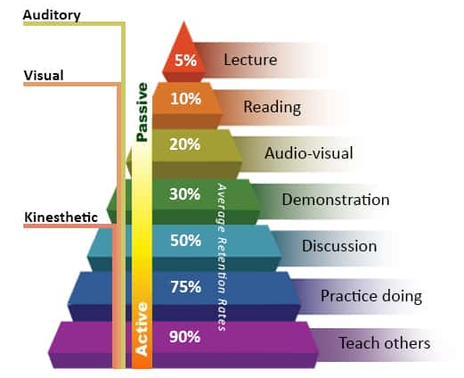
Learning Pyramid
HackVie | Manufacturing SOPs | 2022
Notes:
75% of people retain knowledge through practice doing or action learning such as
Source:https://www.educationcorner.com/the-learning-pyramid.html

Slide 15
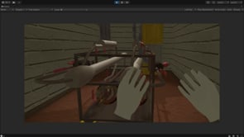
TrainVR
https://www.youtube.com/watch?v=ISM7dHCCAnI
HackVie | Manufacturing SOPs | 2022
Notes:
Here you can see how people will be physically acting out what they will be doing in the lab

Slide 16
Demo
Insert demo video
HackVie | Manufacturing SOPs | 2022

Slide 17
Future vision using virtual reality
Prior to arrival
On-site training
Re-training
Library of VR trainings (developed with subject matter experts) to be completed before employees even arrive
Expedite on-boarding
Modular trainings to be reused across the company
Complement augmented reality (AR) and/or in-person training to reinforce prior knowledge
Ease of knowledge transfers
Eliminate the risk of work accidents and prevent financial liabilities
Ensure smooth audits from potential vendors or government
Readily accessible training for review without the need for a trainer
Refreshers for employees returning after extended leave or vacations
Reduce employee turnover
HackVie | Manufacturing SOPs | 2022
Notes:
Recommendations: AR
Cross Trainings
How often do the audits happen?
Canada Health: 2 weeks(Trainings Records)--> observe operators with the SOP Manuals ( by the Step by Step) Random Audit
Potential Vendors popping up randomly
GXP world

Slide 18
Why TrainVR?
"At AbbVie, we know supporting the development of our employees impacts our ability to develop and deliver innovative medicines to patients around the globe. That’s why we invest in our people and their growth, helping them gain specific enterprise-critical capabilities to develop, build and find purpose in their careers."
HackVie | Manufacturing SOPs | 2022
Notes:
Are you playing a video game? YES AND I’m getting my training done

Slide 19
Why TrainVR?
"At AbbVie, we know supporting the development of our employees impacts our ability to develop and deliver innovative medicines to patients around the globe. That’s why we invest in our people and their growth, helping them gain specific enterprise-critical capabilities to develop, build and find purpose in their careers."
The integration of Virtual Reality will provide employees with effective, efficient, and compliant training starting day one of their AbbVie journey.
HackVie | Manufacturing SOPs | 2022
Notes:
May cut this depending on workshop
if we keep it: talk about the future of where this could lead, trainees across AbbVie, fewer lab risks (even safer environment), cut costly training(instructors, cross training,
Career Pipeline Sample Trainings: Nurturing leadership potential and new career opportunities within AbbVie.
Source: https://www.abbvie.com/societal-impact/for-the-growth-of-our-employees/developing-our-peoples-capabilities.html
Currently with AbbVie's Learn. Develop. Perform program, employees are provided with ample opportunities for leadership potential. How can we qualify someone from day one? * how to fast pace training
Aligning with Abbvie's strategy( highlighting the important sentence)
SOP is gamfied ( teaching but in a fun way) How might collaboration become involved in VR)

Slide 20
Vote for Team AbbVie

Slide 21
Q&A
Notes:
How do we assurance the quality?
Audit( competency of the operators in addition of the manuals
How comfortable these operator are?
How do we bring this understanding to the major stakeholders?

Slide 22
Thank You!

